Slide 1
Data Catalog
DAPD Benson Wu

Slide 2
What’s Data Catalog ?

Slide 3







Data management for big data and self-service analytics
Easy to find
Understand data
Data access
Data Catalog

Slide 4
Google Data Catalog

Slide 5
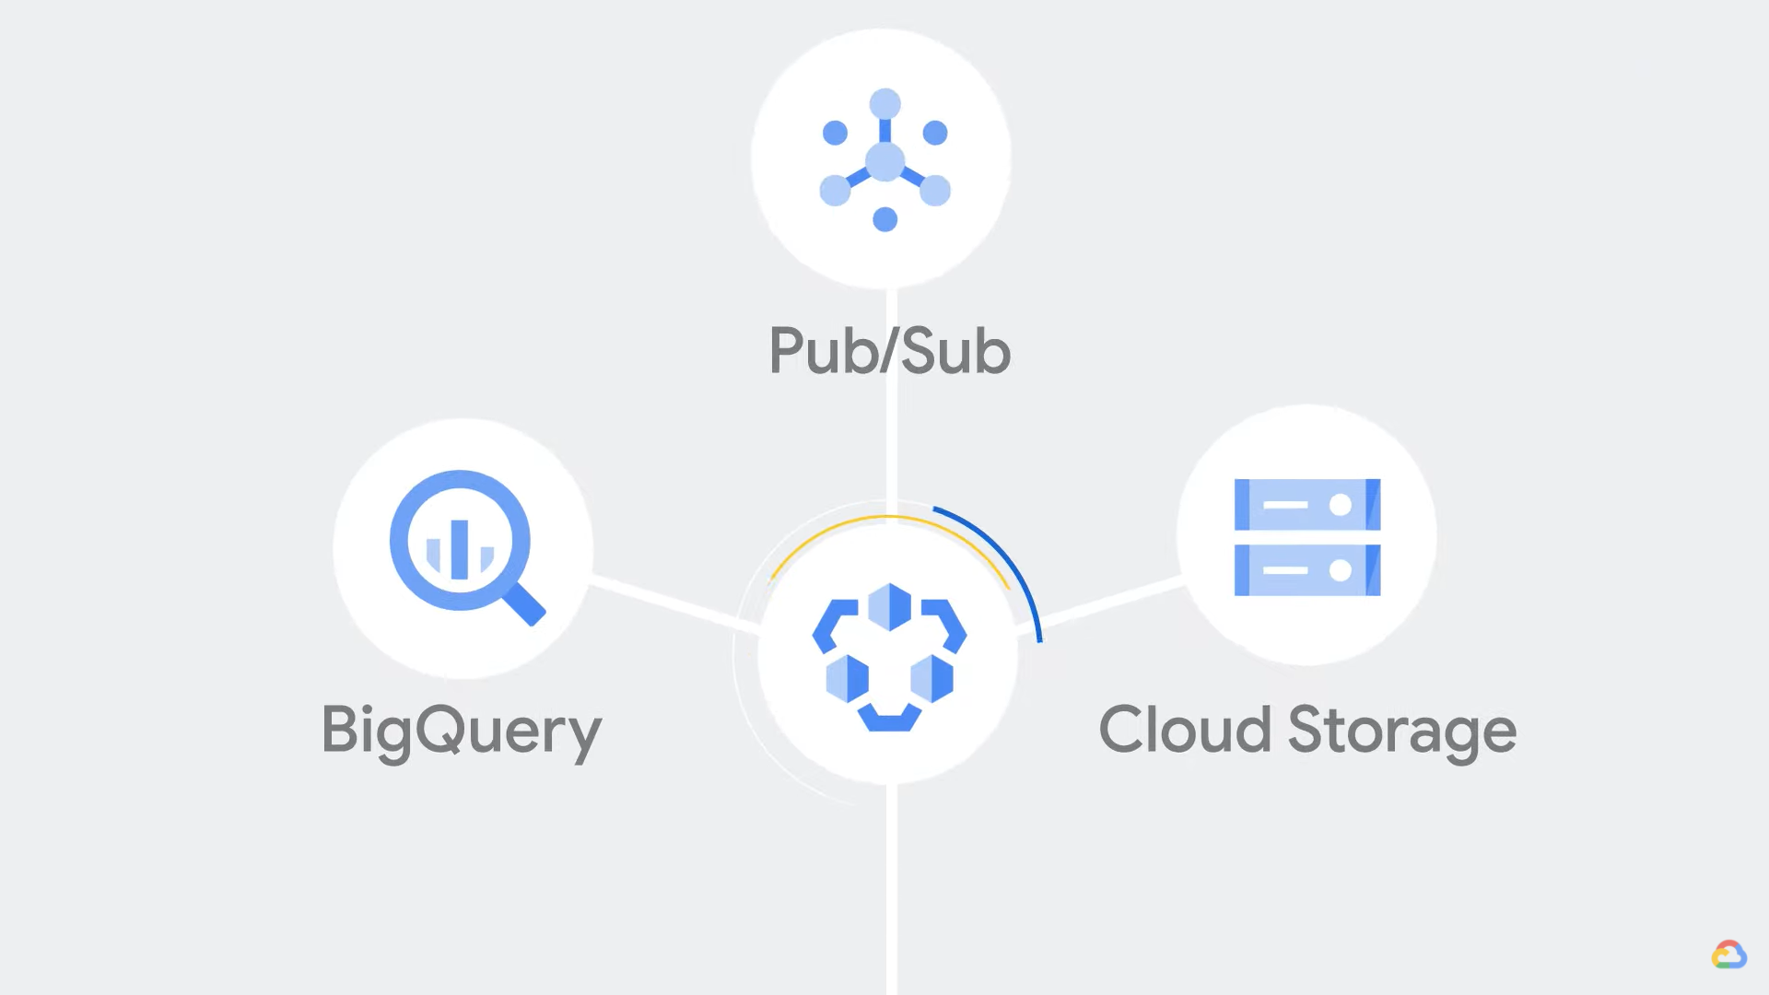
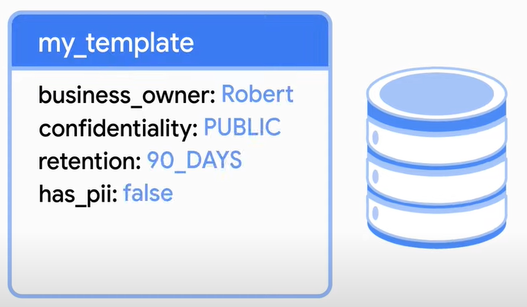
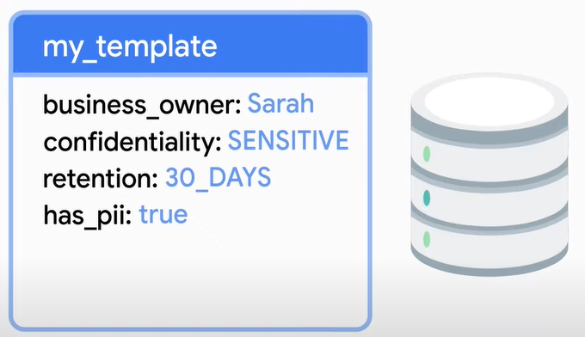
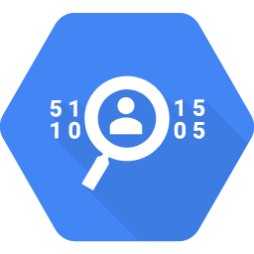
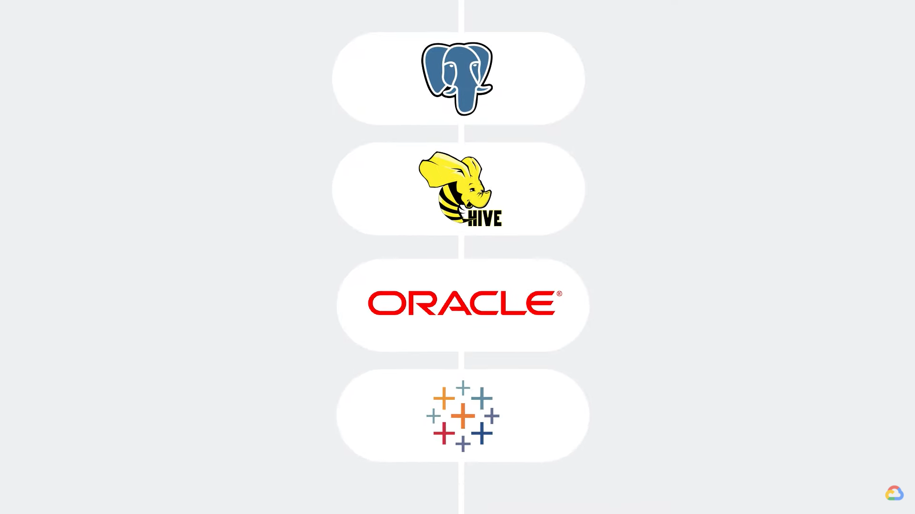
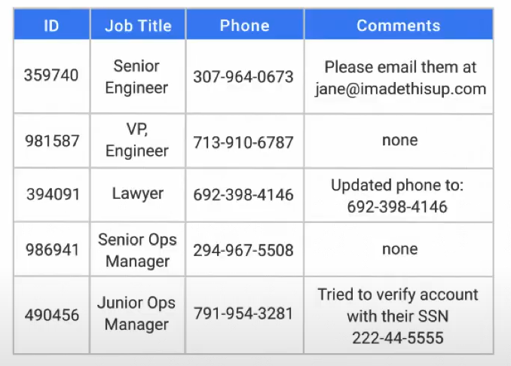
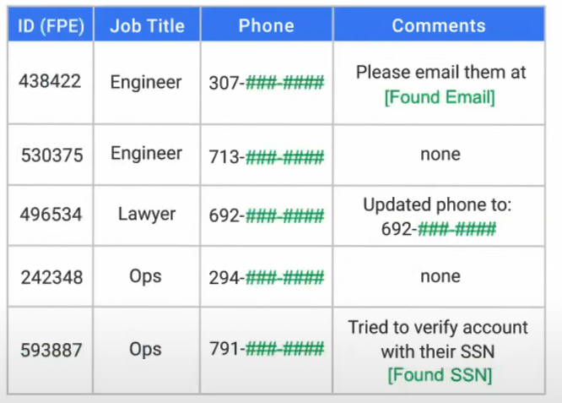
Non-GCP data assets
Data Loss Prevention (DLP)
Notes:
Data Owner, Quality, tag, classification

Slide 6
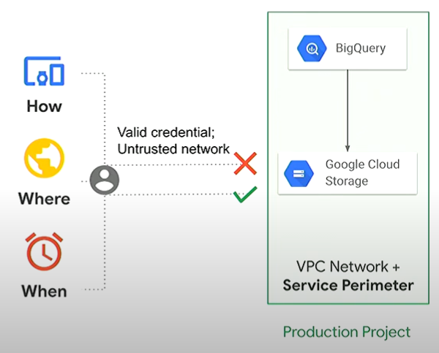
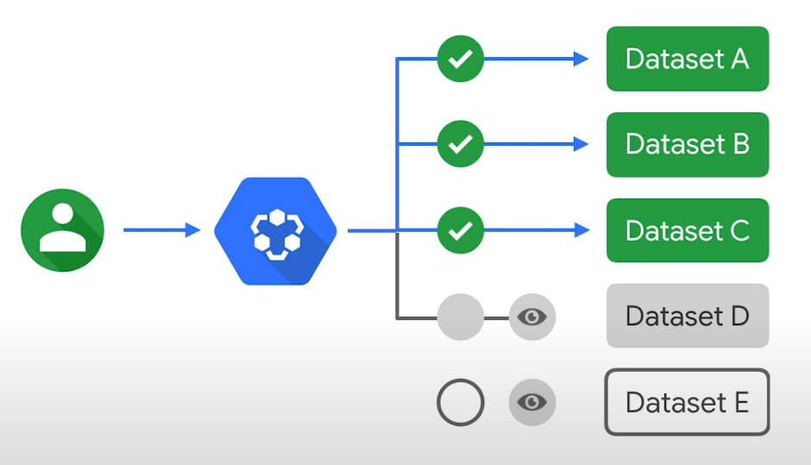
Metadata access governed by
Identity and Access Management (IAM)
VPC Service Controls perimeters
Permission
Role
Notes:
減輕數據洩漏的風險，可以保護指定的資源或是數據

Slide 7
Our Data Catalog

Slide 8
Ingestion
Searching
RDB
Hbase
Cassandra
Data Owner
Data Quality
DAO API
SDM Portal
Security
Visualization
A&A
Invalid IP
Data Flow
DAO Usage

